Slide 1


Data Science with Cloud Computing
(ADS-508-IN1)
Reducing Late Deliveries
- CartWave Marketplace
Presented by:
Praseeda Saripalle and Bhrami Zadafiya Team 3

Slide 2
Agenda
Business Problem
Why This Matters
Our Approach
Data Used
Key Insights
What We Built
Business Impact
Recommendations
Conclusion

Slide 3
Problem Statement
Understanding the Delivery Challenges
The Problem
• Increasing late deliveries
• Poor customer experience
• Negative reviews and complaints
• Reactive decision-making
CartWave currently reacts to delays instead of preventing them

Slide 4

Why This Matters
• Decrease in customer satisfaction
• Loss of repeat customers
• Increased support costs
• Reduced trust in sellers
Even small improvements can significantly impact revenue

Slide 5
Approach Overview
Proactive Strategies for Improvement
1
IDENTIFY DELAY PATTERNS
3
ENABLE PROACTIVE ACTIONS
2
4
PREDICT HIGH-RISK DELIVERIES
ANALYZE PAST ORDER DATA

Slide 6

Data Utilization
Essential Information for Analysis
• Order details and timelines
• Delivery and shipping information
• Payment behavior
• Customer location data
Each order analyzed from multiple perspectives

Slide 7
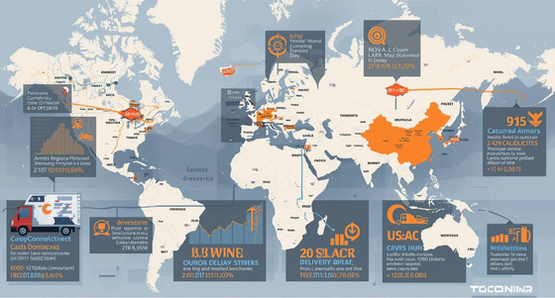

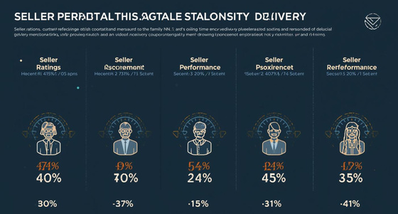
Key Insights for Reducing Late Deliveries
Regional Delays
Certain areas experience significant delivery delays consistently.
High Freight Costs
Increased delays correlate with rising freight costs.
Seller Performance
Variability among sellers leads to inconsistent delivery experiences.

Slide 8
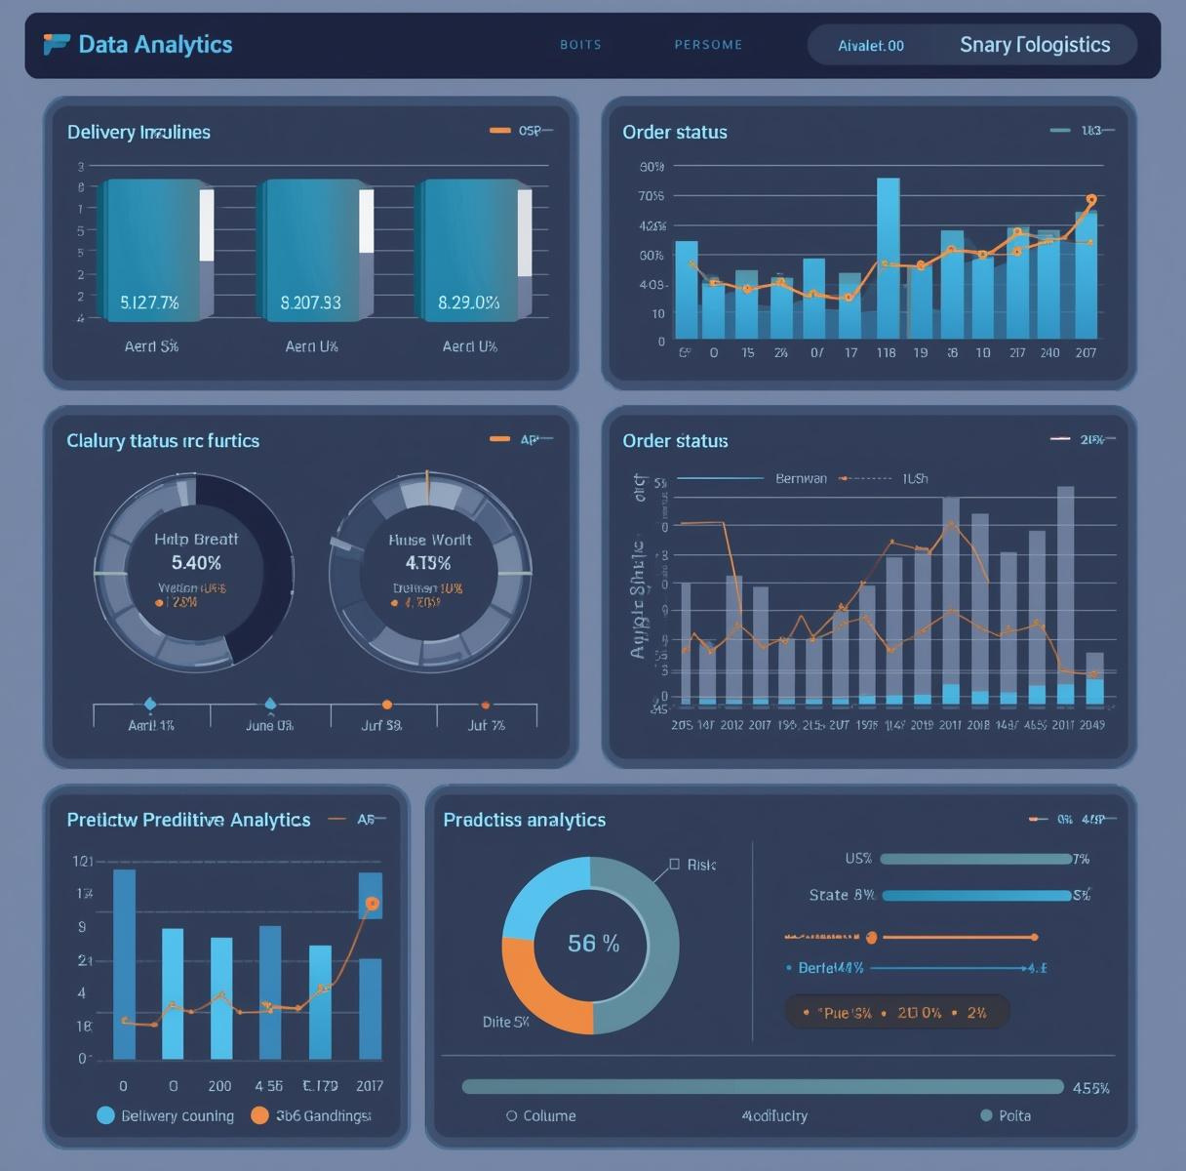
What We Built
A system that predicts:
Will an order be delivered late?
• Identifies risky orders early
• Uses historical patterns
• Supports better decision-making

Slide 9
Business Impact
Enhancing Delivery Logistics Efficiency
Early Detection
Improved Communication
Better Planning
Implementing a predictive model allows for early identification of potential delivery issues, enabling logistics teams to respond swiftly and mitigate risks before they affect the customer experience.
Proactive notification systems can help keep customers informed about their order status, fostering a sense of trust and transparency, which are essential for enhancing customer satisfaction and loyalty.
By analyzing delivery data, our team can optimize logistics operations and strategically allocate resources, ensuring timely deliveries and reducing costs associated with delays, ultimately benefiting the bottom line.

Slide 10
Recommendations
Prioritize Orders
Focusing on risky orders allows us to address potential delays proactively, ensuring timely deliveries. This prioritization enhances customer satisfaction and minimizes negative feedback from our valued clients.
Strategies for Enhancing Deliveries
Monitor Sellers
Regularly assessing seller performance helps identify those who struggle with timely deliveries. Implementing a monitoring system allows for targeted support and ensures consistency in service quality across all sellers.
Notify Customers
Keeping customers informed about their order status is essential. Proactive notifications about potential delays foster trust and transparency, leading to improved customer relationships and reduced support inquiries.

Slide 11
Conclusion
• Late deliveries can be predicted
• Data enables proactive decisions
• Improves customer satisfaction
• Supports business growth
Data-driven decisions can transform delivery performance

Slide 12
Thank You!

